Slide 1

Project PASSHOLE
TJ Moyers
Kyle Etsler
Andy gale
Raphael o’flynn

Slide 2
Project goals
Easily manage passwords for all of your websites and services
Reminds you to change your password

Slide 3
Application flow
Login
List
Details

Slide 4
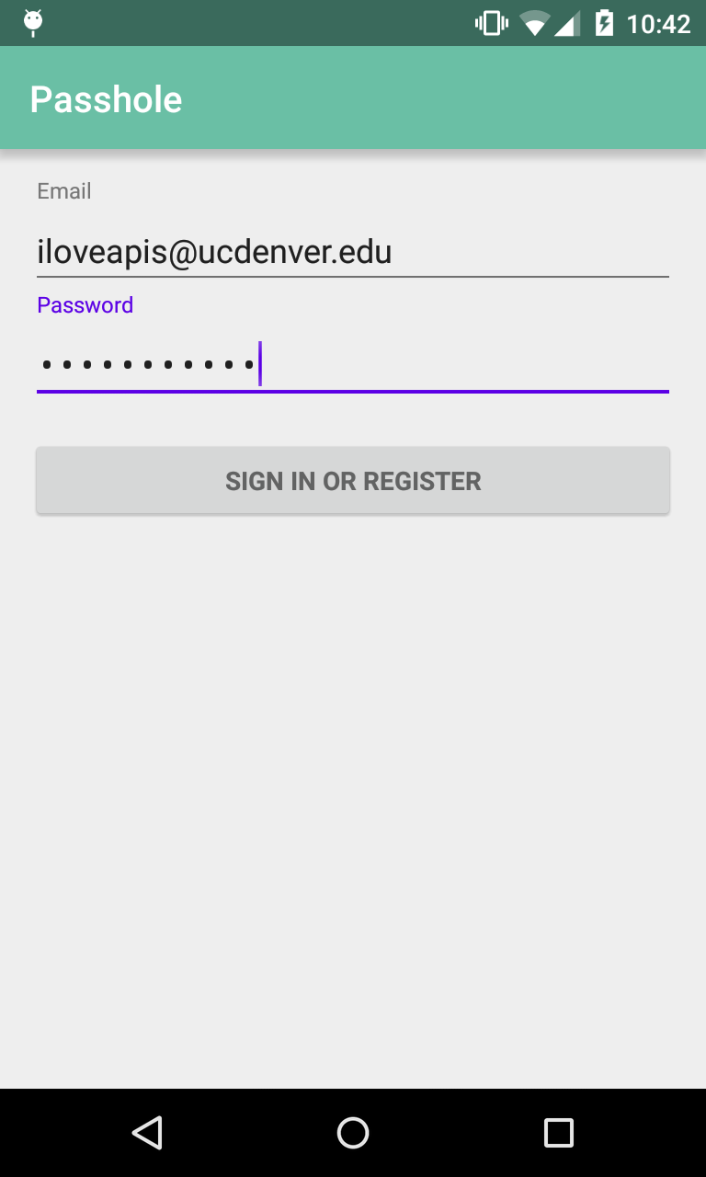
LOGin
Simple login interface
Allows users to sign in or register

Slide 5
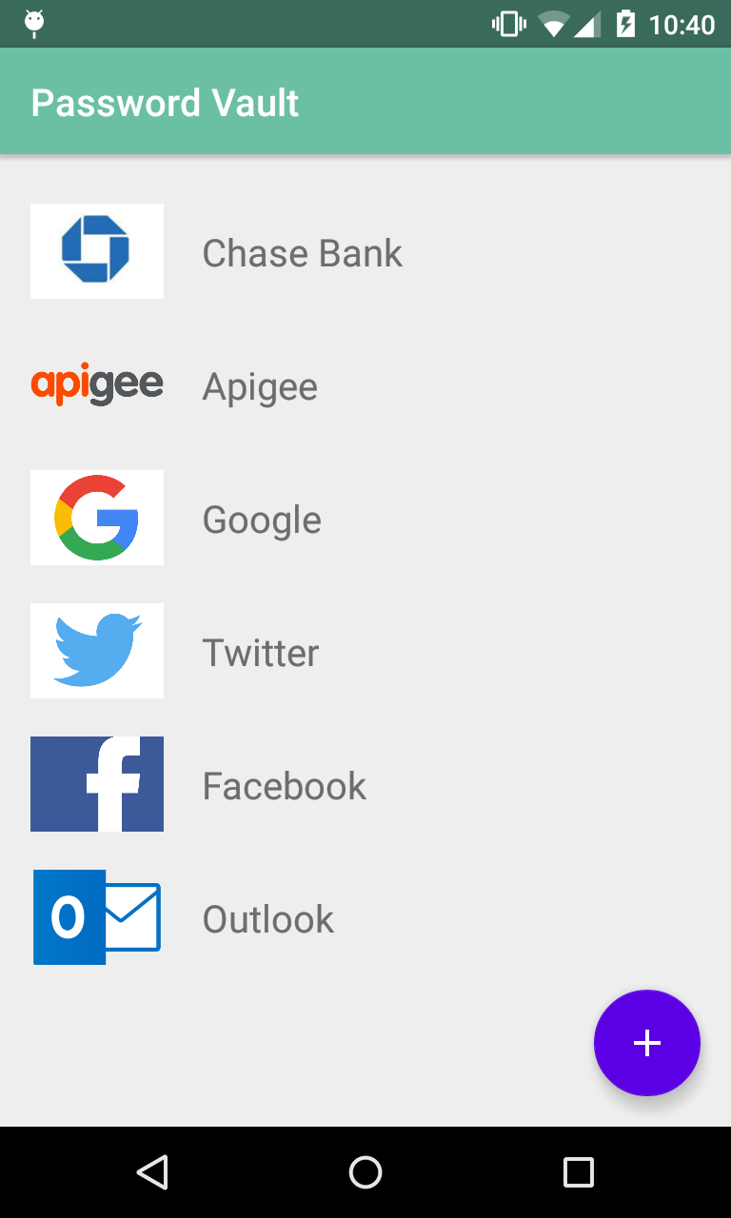
List
List (AKA Vault) displays all saved passwords
Gives ability to add, edit or delete
Tap for details

Slide 6
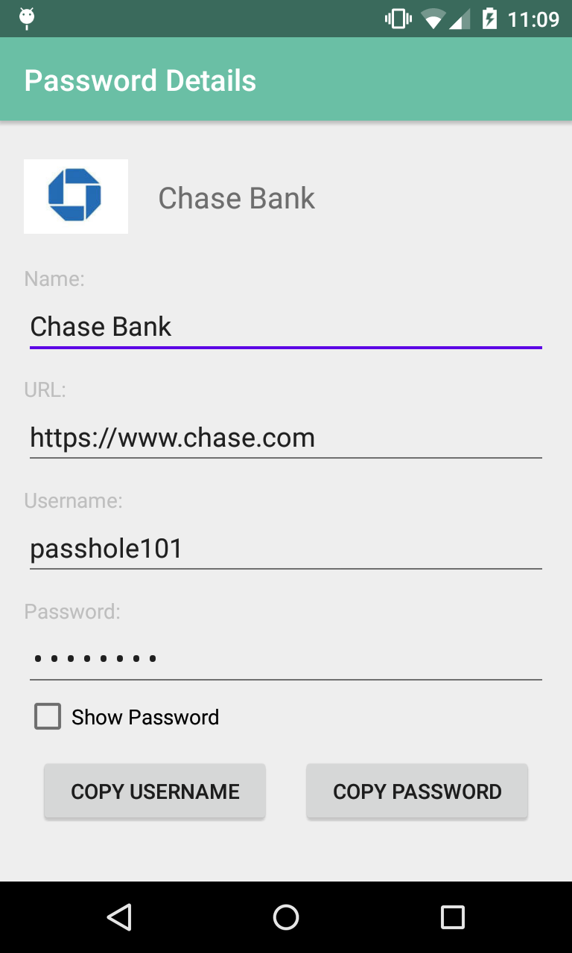
details
Gives detail of saved passwords
This is where modifications are made
Will store when passwords are set
-Reminds you to update passwords

Slide 7
It’s a feature not a bug
Keeps note of when the password was set, reminding you to make a new one.
Multiple accounts, same service supported.

Slide 8
Plans for growth
Option to automatically update passwords, not just remind you to.
Fingerprint scanner support.
Mobile app integration. “Sign in with Passhole”

Slide 9
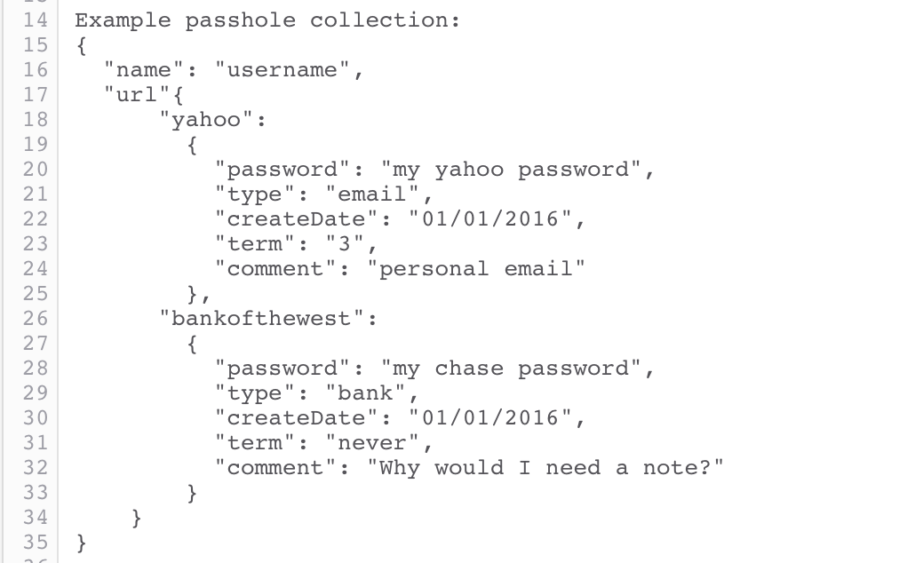
Example collection

